Slide 1

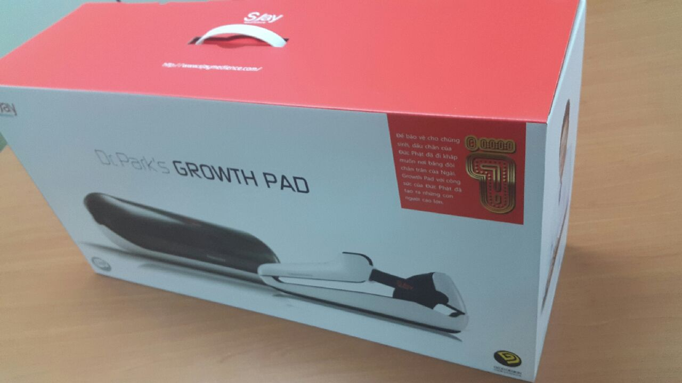
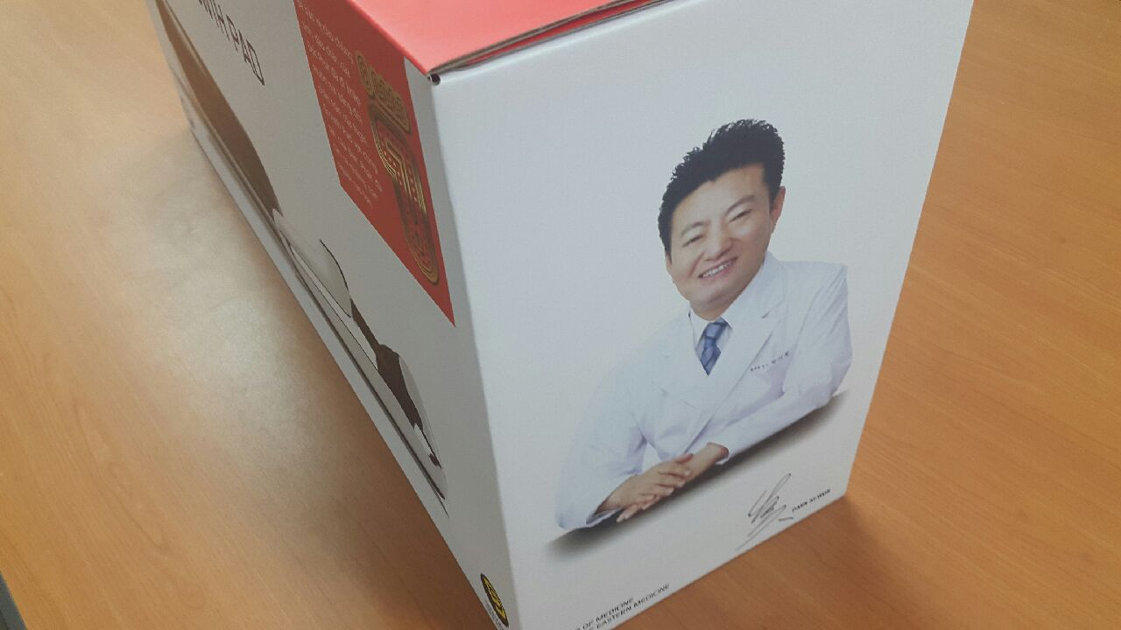

Medience
Dr. Park’s Growth Pad with
Electric UV Sterillizer

Slide 2
Overall Company
Seo-Jung oriental medical clinic was the matrix of S Jay Medience Co.Ltd
Seo-Jung oriental medical clinic regarded as one of the representative height -growth clinic in Korea Specialty in the precocious puberty and children growth
“Dr. Park growth centers” has been opened the 31 branch offices in China (Beijing ,Shanghai, Guangzhou, etc), which are at the forefront of the globalization of the height growth industries.
S Jay family legal entities : S Jay Medience, SJ oriental medical clinics, SJ clinics
S Jay B-boys and Height stature foundation for children of unification in Korea .
Business area : Medical device, Health functional foods and Skin care
Korea Medical Grand Award for 8 years running by MOHW

Slide 3
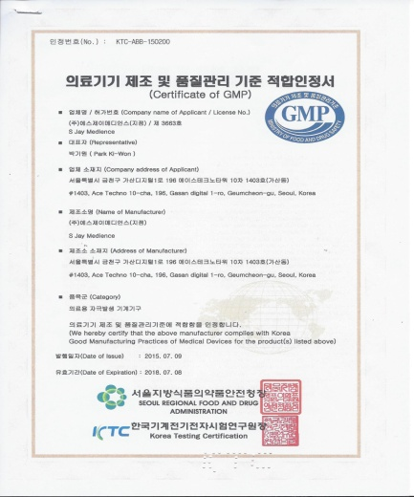
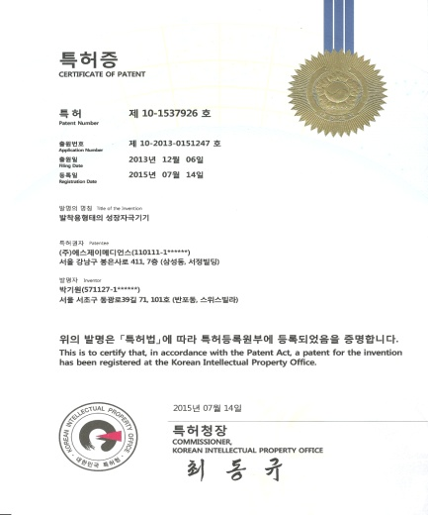
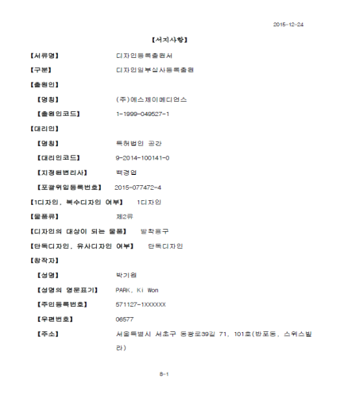
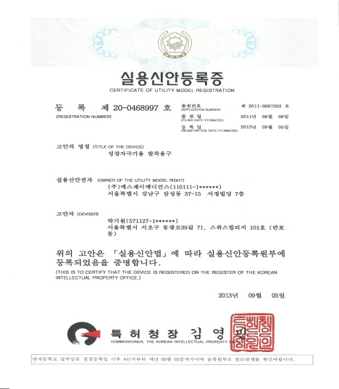
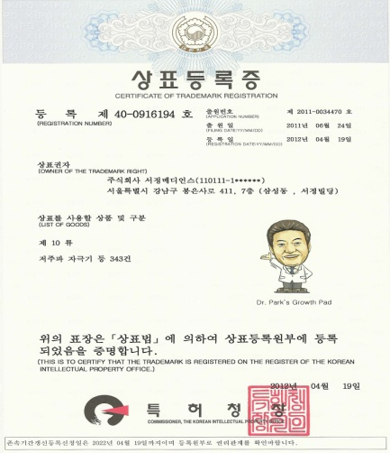
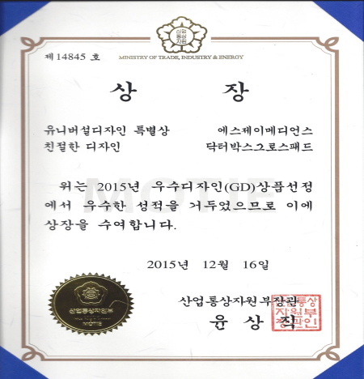
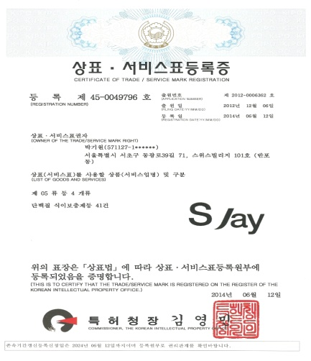
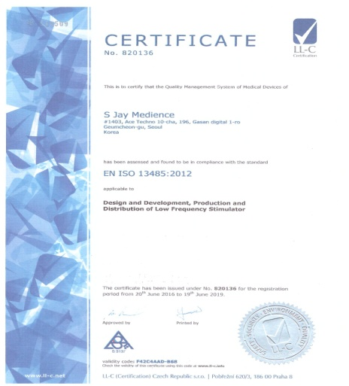
[Company reward and certification]
1 .Certificate of GMP
2. Certificate of a Patent
(Growth Pad)
3. Certificate of Design Registration
(Growth Pad)
4. Certificate of Utility Model Registration
(Growth Pad)
5. Certificate of Trademark Registration
( Growth Pad)
6. Good Design Award
( Growth Pad)
7. Trademark / Service Registration
(Kids Plus)
8. Certificate of I SO 13485

Slide 4
Dr. Park Activities
Several media appearance on height-growth as a main speaker and lecture ( TV & Newspaper )
Several articles and books on the precocious puberty and children growth related to medication therapy, exercise control and food therapy.
Several articles on newspapers in Japan
Introduce the practical operation cases of oriental growth -clinic at on the news papers and academic seminars
Article on oriental medicine for growth at international medical journal.
A round table talk on children growth invited by Tokyo Medical Association in Japan
A press interview on the growth of the teen-age children at Shanghai , China
Published Dr. Park’s column on “ Growing youth “ at the news papers in Japan.

Slide 5
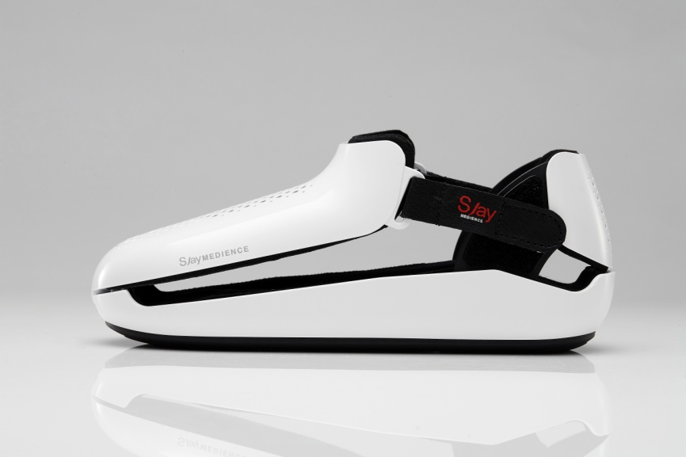
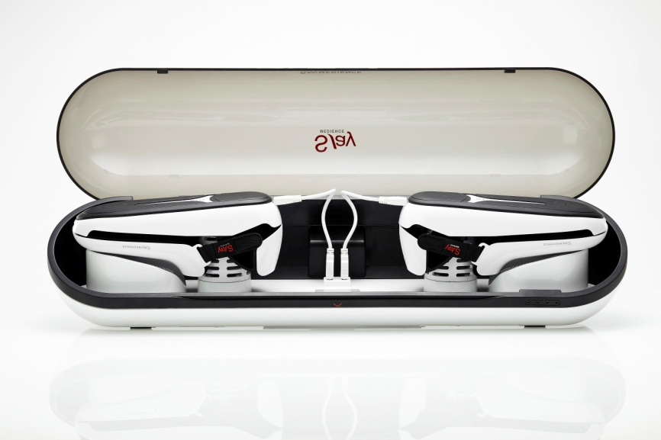
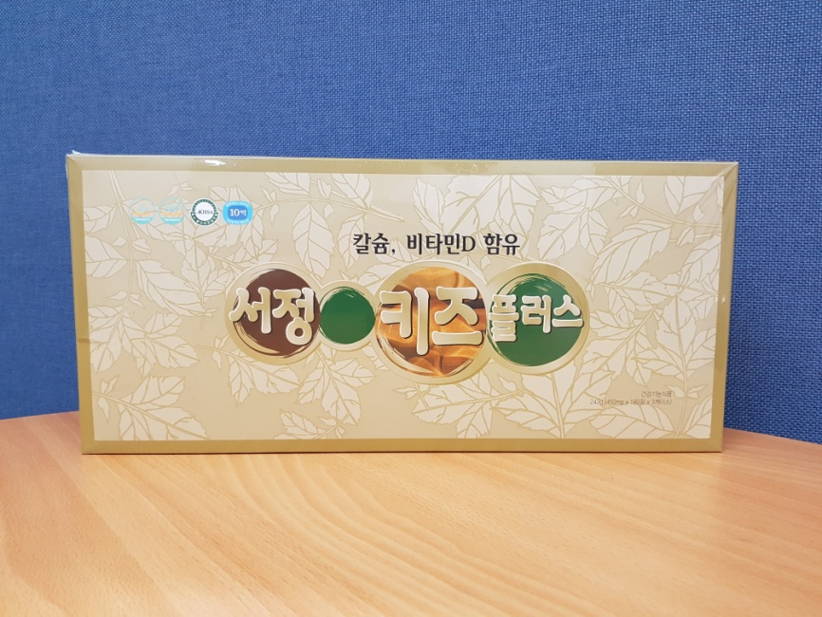
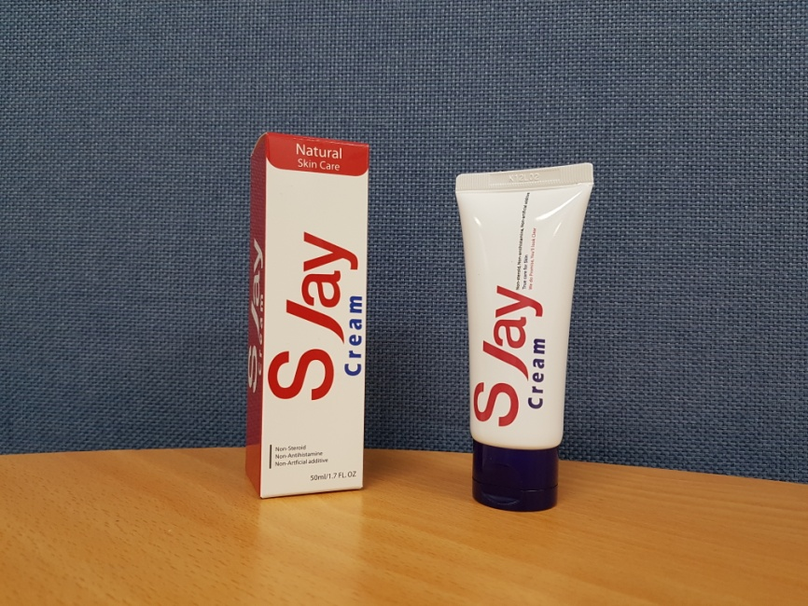
Main Product
Dr. Park Growth Pad
Seo-Jung Kids Plus
S Jay Cream

Slide 6
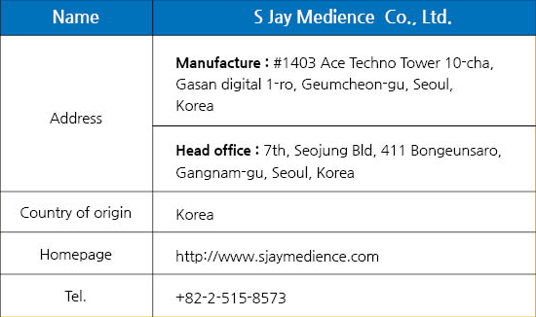



[Manufacturer Information]

