Slide 1
20
MAZUOKA
INTRODUCTON
17
http://mazuoka.com

Slide 2
MAZUOKA
02 page
Contents
02 page
Contents
03 page
History Brand Introduction
04 page
Management Philosophy / Goal
05 page
Headquarters location / Manufacturing plant location
06 page
Production Process and Raw Materials
07 page
Product Features
08 page
Distribution Route
09 page
Sales Trend
10 page
まつおか Brand Competitiveness
Mazuoka
ZwiebelMuster

Slide 3
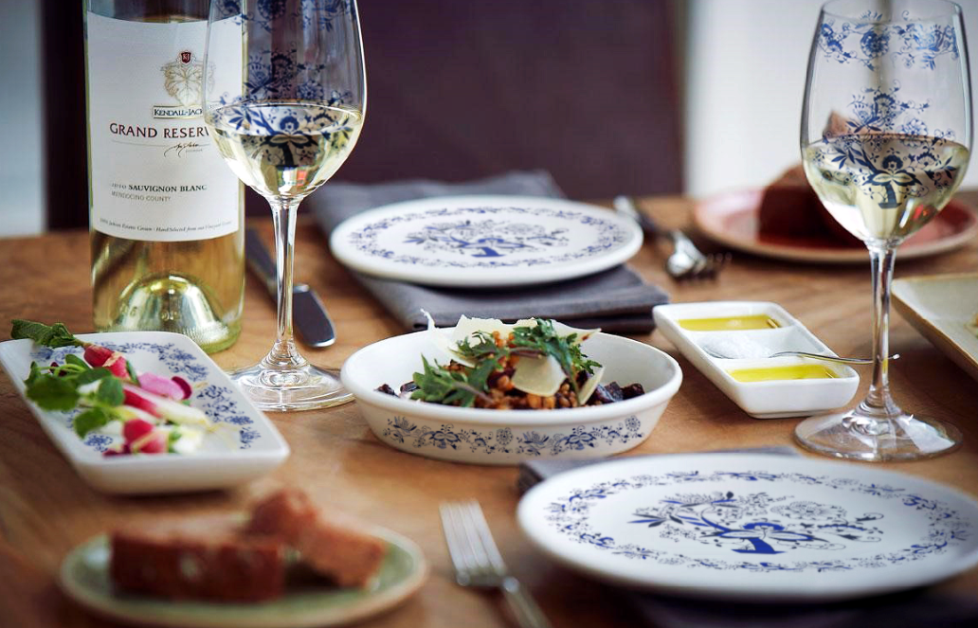
MAZUOKA
03 page
Growing continuously
Luxury Tableware Brand MAZUOKA
MAZUOKA – History
2005.01.05 Established Jiyoonine
2006.10.01 Mazuoka product import and sale (Established online mall)
2007.03.20 Acquisition of Mazuoka trademark and copyright
2008.03.28 Launched home shopping in 3 companies, open market and many other online traders
2011.12.01 Consignment operation of Mazuoka Korea plant and all products in production
2012.01.01 Launched Zwiebel Muster / Siroi Yuki
2012.02.01 Consignment at famous department stores nationwide
2013.05.01 Wemakeprice/ Timon tableware brand launch
2014.05.01 GS / CJ O shopping main brand launching, sales of 800 million won in second half
Launched Hanssem brand direct store and opened 8 shops nationwide
2014.12.01 Growing online sales and nationwide store expansion
2015.06.01 Operated 14 directly managed stores nationwide
2015.06.30 Sales reached 1.3 billion for the first half
2015.07.01 Cheonan direct factory production operation
Daegu logistics warehouse operation
2015.08.06 Directly managed store in Daegu OPENS
2016.03.23 Directly managed store in Suwan OPENS / Operate 10 Hanssem
direct management stores
2016.09.09 Hanam Starfield direct management store OPENS
2016.10.20 20 MAZUOKA direct management store are operational

Slide 4

MAZUOKA
04 page
Prioritize trust with customers
Pay attention to MAZUOKA!
Creating the Best Product Service for Customers. Achieving the highest profitability in the industry, Matsuoka is confident.
Customer Satisfaction Management/Trust/Safety/Humanity
Safety
Continuous R & D
Regular product quality inspection
Customer
Satisfaction
Management Philosophy
Customer
Satisfaction
Realize customer satisfaction
Realization of customer defect rate of ZERO
Safety
Trust
Ensuring product reliability
Product first, best quality in the industry
Trust
Human
Humanity
Pursuing human-centered values
Leading thinking
Young-minded adventurous thinking

Slide 5
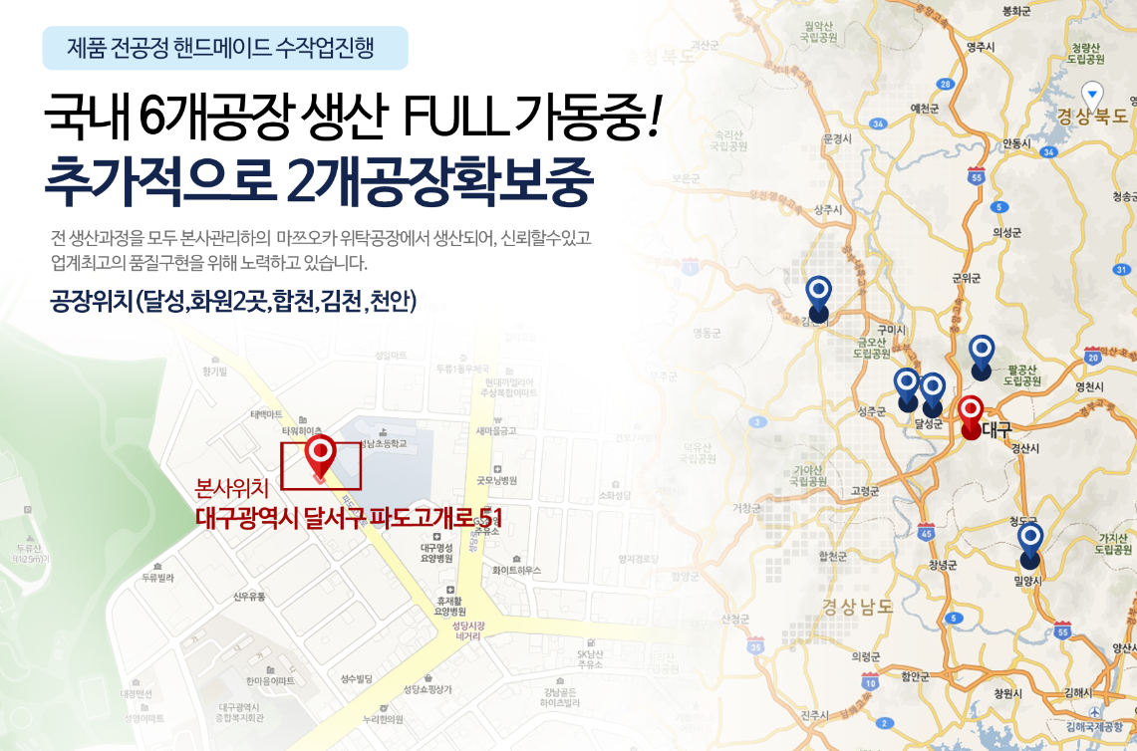
MAZUOKA
05 page
All products handmade for all process
6 factories in Korea are in full operation!
Two additional factories are being acquired
All production processes are produced at the MAZUOKA factory under the management of our head office, and we strive to be reliable and to achieve the highest quality in the industry.
Factory locations (Dalsung, 2 locations in Hwawon, Hapcheon, Gimcheon, Cheonan)

Slide 6
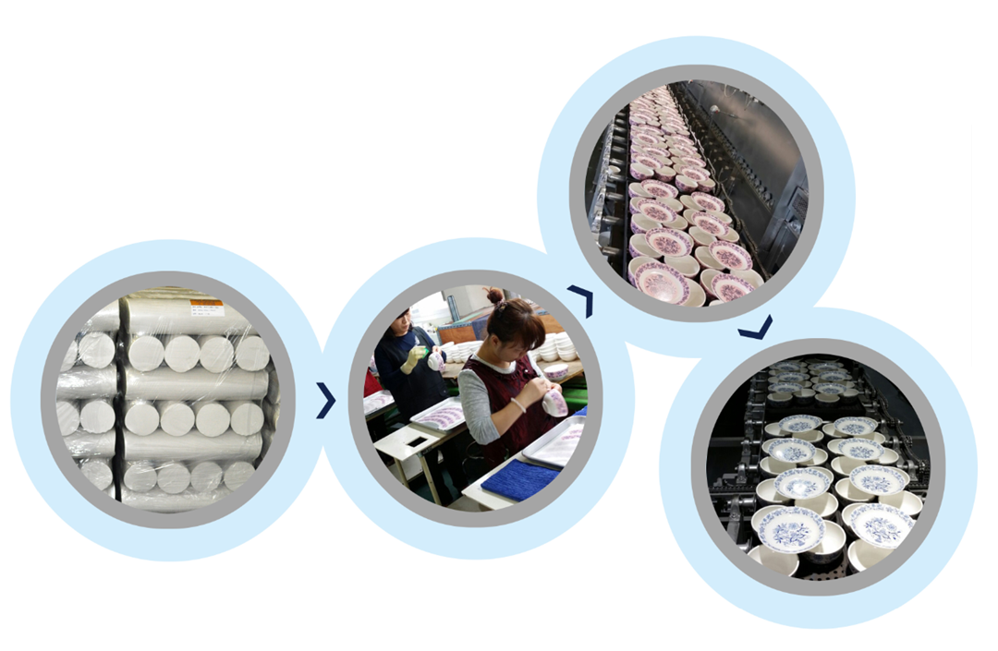
MAZUOKA
06 page
A combination of sophisticated design and fine raw materials
All products use proven raw materials!
Production process at Kimcheon factory

Slide 7
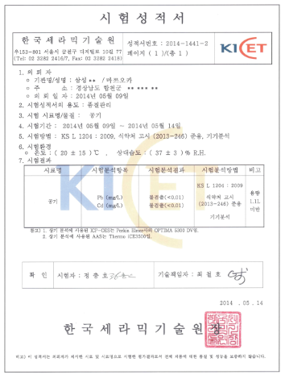
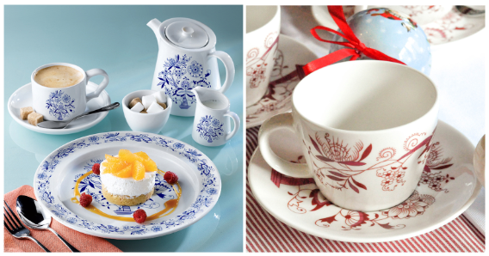
MAZUOKA
07 page
The "trustworthy tableware" that the whole family can use
ZwiebelMuster Tableware!
Lead free, cadmium free. Officially proven safe products
The only dishware brand that has price competitiveness and product quality at the same time
Mazuoka, a high-class pottery brand in Korea, is a representative brand in Korea that makes all its products by hand.
Combined with product development and craftsmanship, the process is also complicated, sophisticated and of high quality. Zwiebel Muster means blue onion flower.
Our handmade ceramic products are a simple and clean product that add a refreshing sensation to the table.

Slide 8


MAZUOKA
08 page
Stable online/offline sales distribution network
Operate 20 direct stores in 2016 and export to overseas!
Online
GS Shop / CJ O Shopping / Lotte.com / Hanssam Mall / KakaoTalk / 11th Street /Auction / Gmarket / Interpark / Itv Style / Wemakeprice /Coupang / Timon and many others online mall
Oline
Offline
Lotte Department Store in Daejeon/Gyeonggi, Lotte Department Store in Busan / Gyeongnam, Lotte Department Store in Daegu / Gyeongbuk,
Donga Department Store in Suseong
Daegu Plaza/Main Store and Masan/Changwon Daewoo Department Store
Hanssem, Inc. direct store (Seoul: Gyeongneung, Bangbae, Nonhyeon, Mokdong, Jamsil, Bundang)
(Gyeongbuk: Busan Centum, Busan Yeonsan, Daegu, Tongyoung, Gwangju Sangmu, Busan Jwacheon, Jeju central)
10 years of business with the original wholesalers, Korean ceramics Daegu distributor/US subsidiary H&H Global Korea/ Busan International Market/Gwangin Trading Company etc.
Stable sales structure
Wholesaler
Direct
store
2015
Re-export through the largest online shopping mall in Japan
Proceed to department stores in the overseas market in Singapore
Hanssem Direct Store, 2 stores in Seoul / 1 store in Busan
Proceed to purchage Hanssem agencies in Korea
Proceed to enter Hyundai Department Store and Shinsegae Department Store

Slide 9
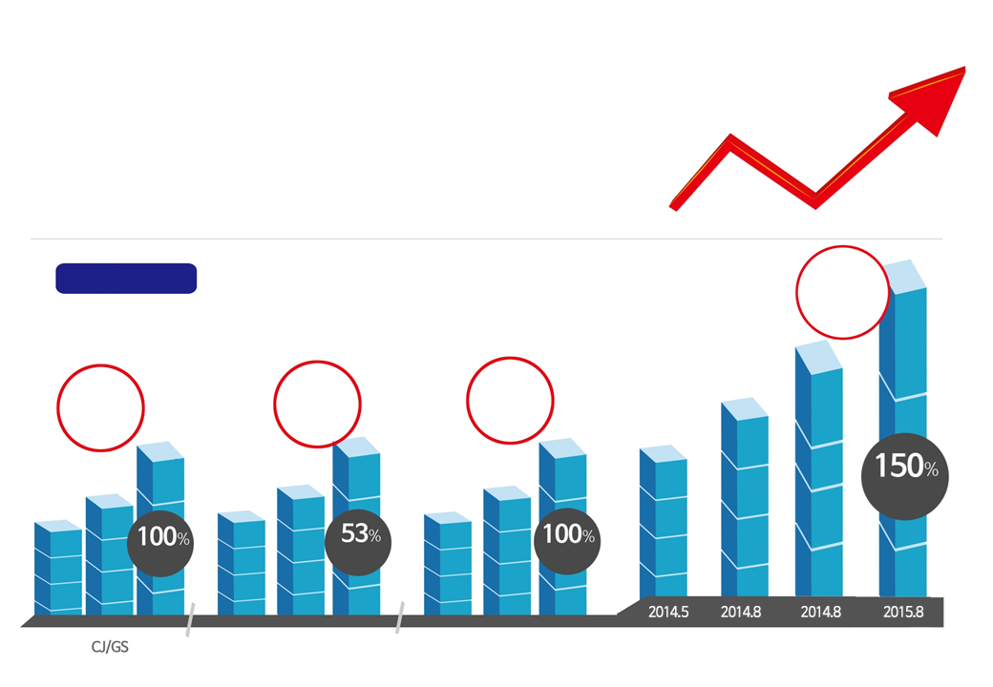
MAZUOKA
09 page
Among ZwiebelMuster products
“Dominant in domestic sales volume” Mazuoka Brand!
Domestic online MD approved sales effect!
Increasing trend
Mazuoka is growing continuously.
It is ongoing.
150% growth
compared to
last years sales
7 more
direct stores
nationwide
Increased sales
of 800 million
in 6 months
Sold 10000
Home sets
Social, open market
and other online malls
Nationwide Wholesaler/department stores/ Hanssem direct stores
Total sales

Slide 10
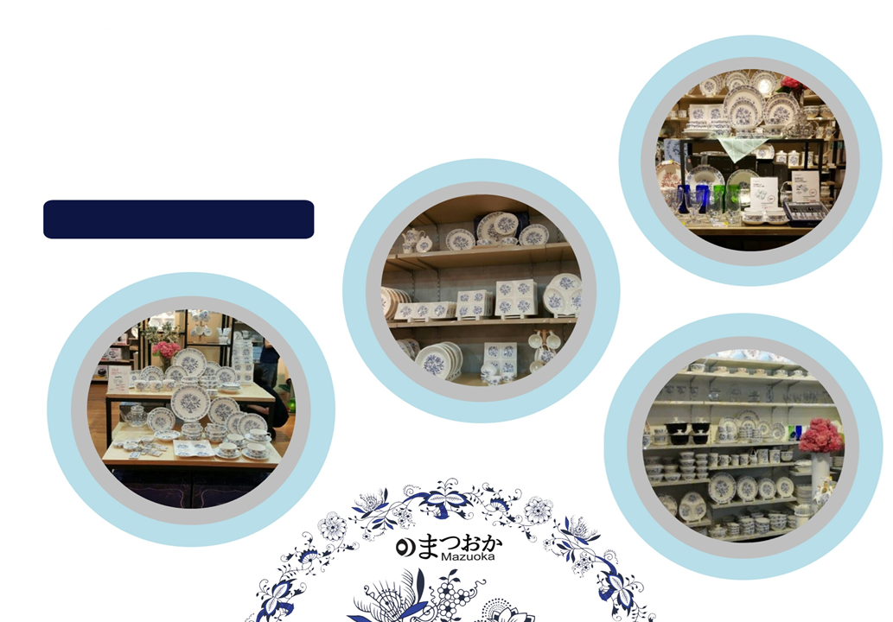
MAZUOKA
10 page
まつおか Brand Competitiveness
- All Mazuoka products are direct from factory production
- Quality inspection is prioritized
- Continuously check on customer complaints
- Continuously check on market prices
“Zwiebel Muster” number one in market share brand power

