Slide 1

Promising techniques to be licensed out
2017.01.23
KOREA MACHINERY IND. INC.

Slide 2


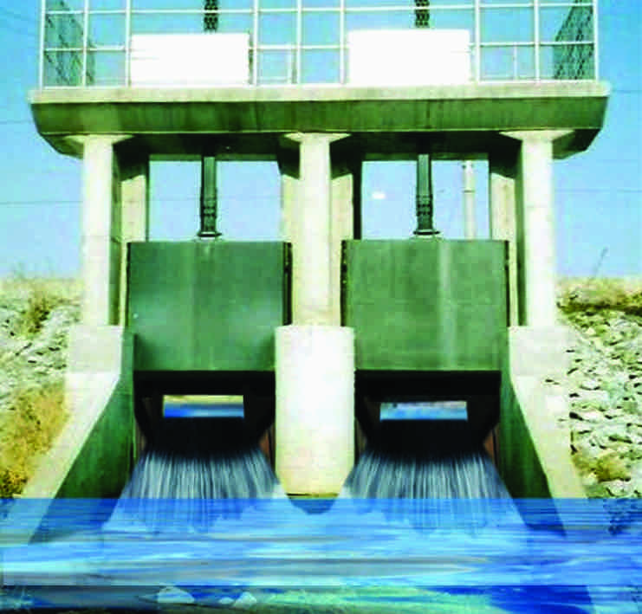
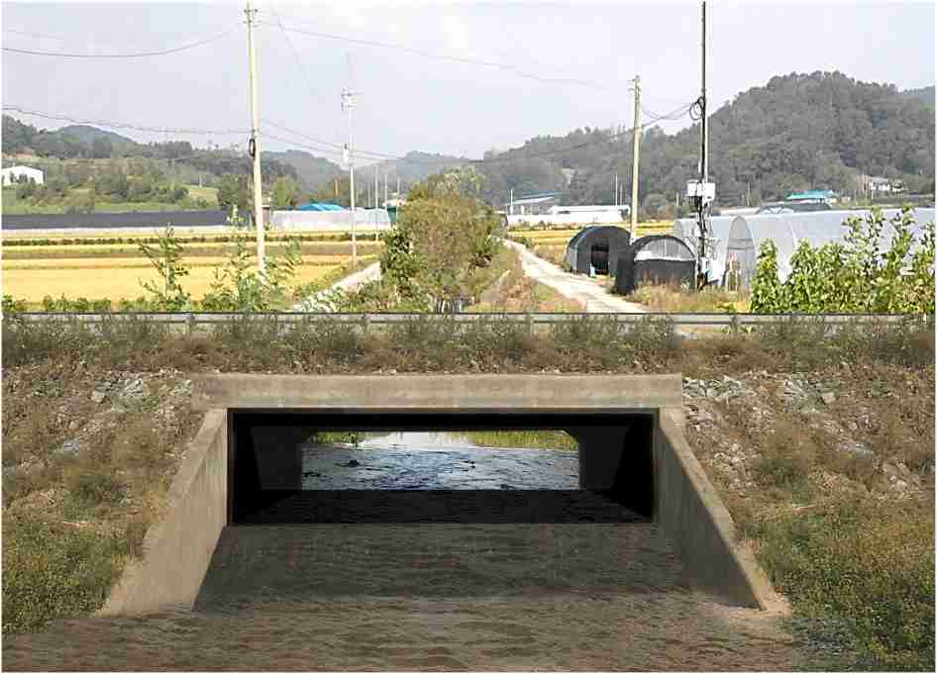
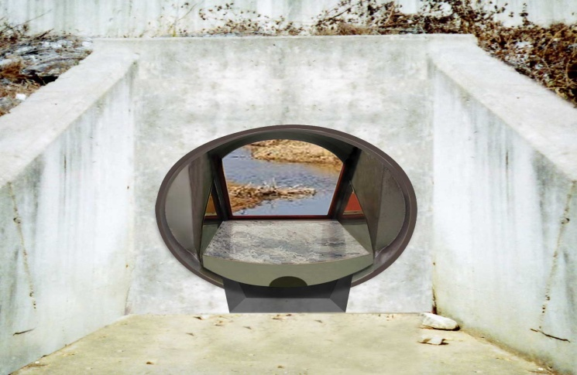
Non-motorized floodgate for preventing back flow
Floodgate ( for seaside and river)
Present Invention
Prior motorized floodgate
Rectangular shape
Circular Shape

Slide 3
Principle
River
Normal state
Floodgate opened
When there were back flow, floodgate automatically closed due to below buoyant floodgate
Buoyant floodgate

Slide 4
Strong point
Needless of power to close floodgate
Automatic closing (needless of man’s decision)
No hindrance such as pillar during normal water flow

Slide 5
Contact us
E-mail: korea269@naver.com
Tel : +82-31-336-8135
Fax: +82-31-336-8136
KOREA MACHINERY IND. INC.

